Slide 1



Growing a vibrant life
science and health ecosystem
in Wallonia, Belgium
Driving health
innovation
biowin.org

Slide 2
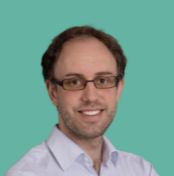
Letter of Intent – Call N°46
You have a great idea for a project in Health Innovation? Congratulations! The BioWin cluster offers to help you analyze your idea and set up your project in the framework of the 46th call for projects.
To do so, we ask you to answer the following 7 questions in a clear and synthetic way. Answers may be given in French.
The deadline for submitting a letter of intent is June 30, 2026. Submissions must be sent to the following email address: rd@biowin.org .
For detailed information on the call for projects, we advise you to contact the cluster:
Loïc Germain
Innovation & Scientific Excellence
Senior Programme Manager
loic.germain@biowin.org / +32 (0)472 65 43 02

Slide 3

Who? Description of the project leader
Who are you? What is your experience? What is your know-how? What are your activities? What is the vision of your company?

Slide 4
Coordinates of the Project Leader
Name of the Company
BCE number
Postal Address
WebSite
Name of the project coordinator
Professional function
Email
Phone Number

Slide 5
Why? Description of purpose and needs
What is the origin and context of the project idea?
What are the identified needs, the triggering factor(s)?
What problems do you want to address? What opportunities have been identified?
In which Strategic Activity Area of the BioWin cluster does your project fit?
Please select one or more area below
  Biopharma
  Health-tech
  Others (specify the technological field)

Slide 6
What? Description of the project idea
What is your idea? How does it meet the identified needs?
What deliverable do you want to obtain at the end of the project?
What product/service/process do you want to market to valorize the results of your project?
How innovative is the project?

Slide 7
Targets? Description of the market
What is (are) the market(s) targeted by your project (size, major trends and macro-economic environment, segments, industry value chain)?
What are the main existing or potential competitors and/or alternative offerings?
Is the exploitation of the expected results dependent on existing patents? Who owns this IP?

Slide 8
How? Description of your strategy
What is your business model? How will you sell your product/service/process? What is your ambition?

Slide 9
With whom?
Describe the consortium
Partners already identified
Missing partners: What skills in Wallonia or outside Wallonia are you looking for to complete your consortium and bring your project to success?

Slide 10
When? How much?
How long will the project last? For what budget?

Slide 11

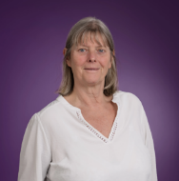
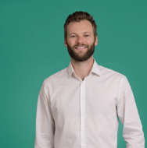
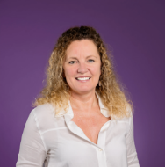
Thierry Ferain
Innovation & Scientific Excellence
Programme Director thierry.ferain@biowin.org
Your Innovation & Scientific Excellence Team
Health Data
Medtech
ATMP
Biomanufacturing
Health Data
Nuclear Medicine
Marianne Ghyoot
Innovation & Scientific Excellence
Senior Advisor
marianne.ghyoot@biowin.org
Thomas Louis
Head of Innovation & Scientific Excellence
thomas.louis@biowin.org
ATMP
Medtech
Nuclear Medicine
Florence De Jaegere
Innovation & Scientific Excellence
Senior Programme Manager
florence.dejaegere@biowin.org
Loïc Germain
Innovation & Scientific Excellence
Senior Programme Manager
loic.germain@biowin.org

Slide 12







Thank You !
Driving health
innovation

